Slide 1


Effect of the Historical Price of Bitcoin on Gold
Sean Beaulieu, Victoria Briazgun

Slide 2
Potential Business Use Case
This project aims to identify any significant events that may have influenced the relationship between Bitcoin and Gold for the past 9 years, which can inform investment strategies
Notes:
The potential business use case for this project was to learn how trends in the historical pricing of the cryptocurrency, Bitcoin, affects the value of other financial commodities, which for this project, is Gold. Bitcoin has a large connotation involving media, and public interest, in what is largely a never before seen financial ‘investment’ (ie: BTC has positive price elasticity).
BTC and Gold are seen as similar assets - investment vehicles with potential for hedging inflation and generating return - however, BTC has had a much more volatile period in terms of price, harboring massive swings during the last several years. Our business use case is to look at historical data and see if there were any events throughout the last ~9 years that can account for BTC influencing the price of Gold.

Slide 3
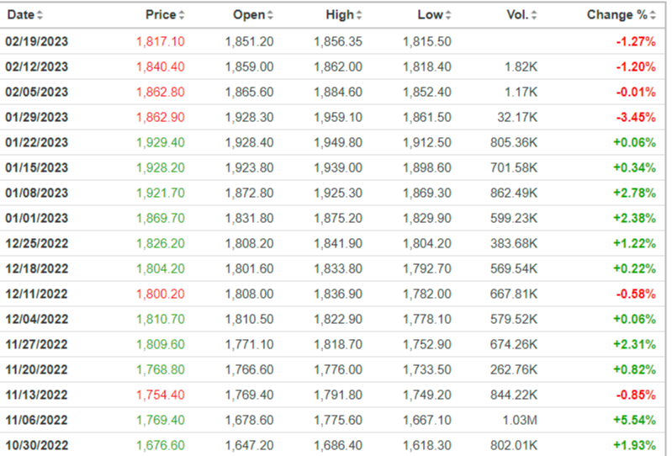
Datasets
Historical Price of BTC_USD
Historical Price of Gold-Futures
11/01/2014
-
2/23/2023
11/01/2014
-
2/23/2023
Retrieved from
finance.yahoo.com
Retrieved from investments.com
Notes:
There are two datasets in this project, both of which are historical pricing data from the two commodities. Note that the 11/01/2014 date is the date which yahoo started to record the price of Bitcoin.
~440 rows of data.

Slide 4

R-Package(s) Used
ggplot2 - visualization of data
(scatterplots, line graphs, regression lines)
zoo - calculation
(the rolling correlation of historical time-series data)

Slide 5
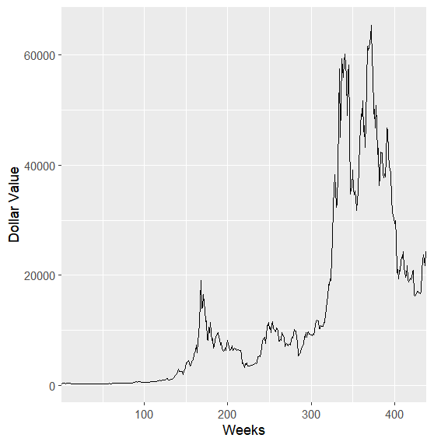
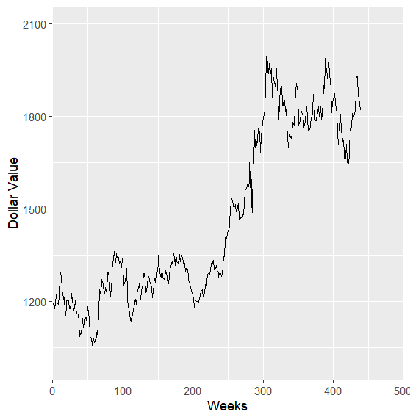
Initial Analysis
Bitcoin
Gold

Slide 6
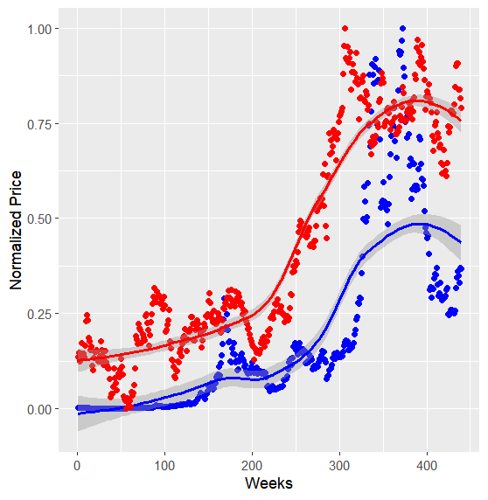
Normalized Price of BTC & Gold
Lines Represent
Graph Shows
The best fit line drawn using local regression
BTC
The price of BTC & Gold increase at a similar rate
GOLD

Slide 7
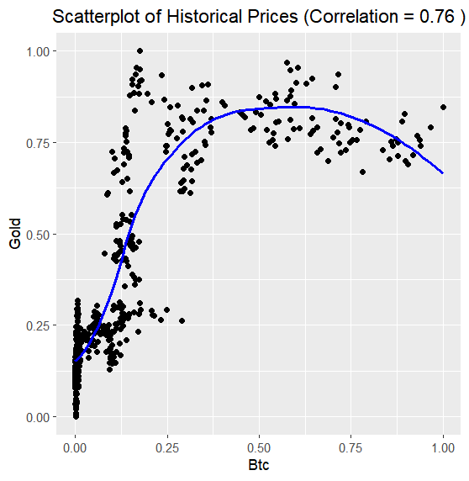
Pearson’s Correlation
ggplot2 represents
Comparative Data
Normalized Weekly Prices
Correlation
Value of 0.76 indicates a strong correlation
Correlation != causation, especially in the case of financial commodities

Slide 8
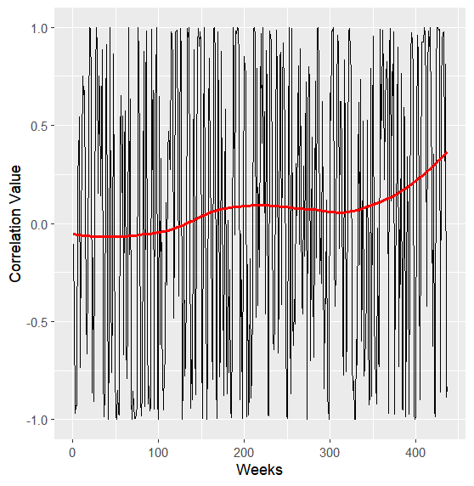
Rolling Correlation
3-week rolling correlation
Every point on the graph is a weekly value containing the correlation between the two prices over the last three weeks
3 areas with sharper rise/fall in correlation:
Weeks ~100-175 (about 10/2016 - 03/2018)
Weeks ~210-310 (about 11-2018 - 10/2020)
Weeks ~320 - 440 (about 12/2020 - 2/2023)

Slide 9

What Happened During Those Dates?
Weeks ~100-175 (about 10/2016 - 03/2018)
2017 first mainstream spike of BTC. Peaked ~$20000. BTC and Gold positively correlated?
Weeks ~210-310 (about 11-2018 - 10/2020)
2018 - 2020 both middling years for value of BTC and Gold, lowering correlation
Weeks ~320 - 440 (about 12/2020 - 2/2023)
After 2020, the price of Bitcoin skyrockets to an all-time high $68000, and Gold also gains in the same time period. Strong positive correlation

Slide 10

Findings
The reason behind the correlation between Bitcoin and Gold is unclear
Possible factors:
Unrelated economic events
(post-2020 massive gains in stock market value)
Hype over Bitcoin
(increase in Gold investments by skeptics)

Slide 11

Recommandations
Compare Bitcoin's price with other commodities/securities
Correlate the number of social media and general media mentions of Bitcoin with the prices of other commodities

